Slide 1
The Transcontinental Railroad Comes to Utah!

Slide 2
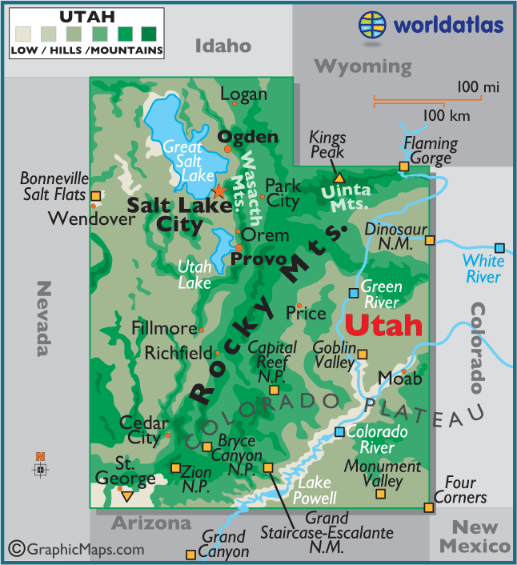
Union Pacific
Notes:
1. Show students the geographical map of Utah. Discuss what types of landforms you see on the map. Ask them about the coloring. What does all the green represent?
2. Have students label the Wasatch Mountains and Uinta Mountains and color the mountains brown. Then have them label the three lakes and two rivers. Then, color them blue.
3. Ask them about transportation. If you wanted to drive from location to another what would you need to consider? Are all roads the same? Where is it easier to build a road? Why is it hard to build a road in the mountains? Why is it easier in a valley?
4. Point out the red dot. This is about the place where the Union Pacific Railroad Company entered Utah. What do you notice about the geography? How might this be a problem?

Slide 3
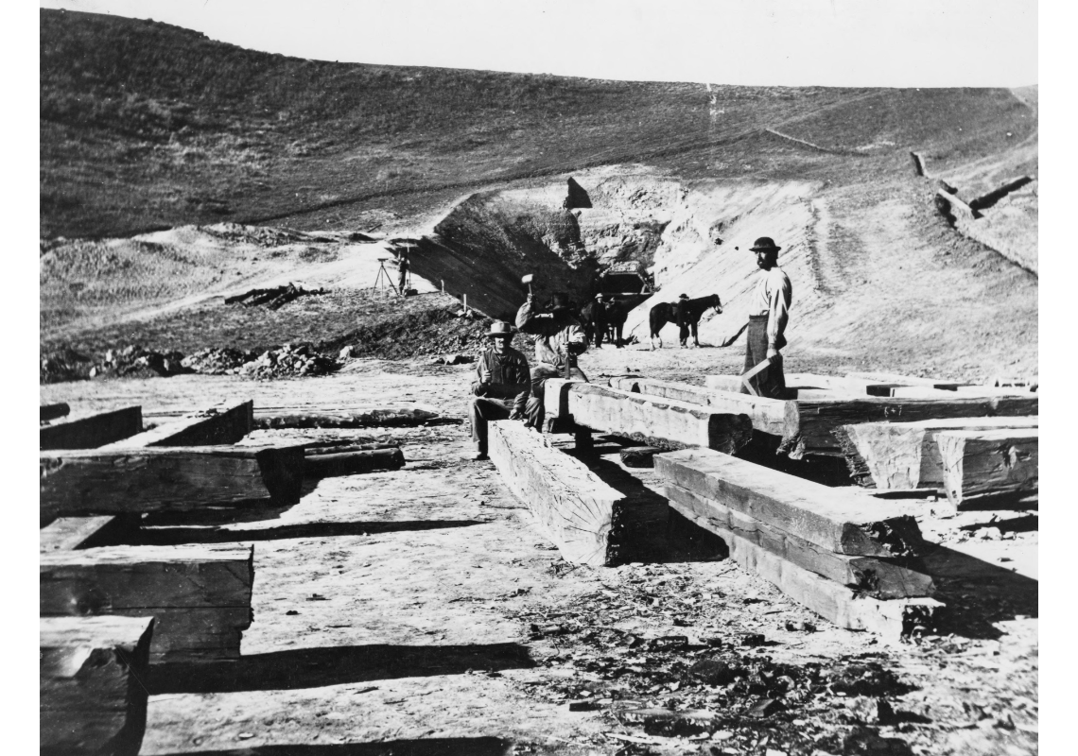
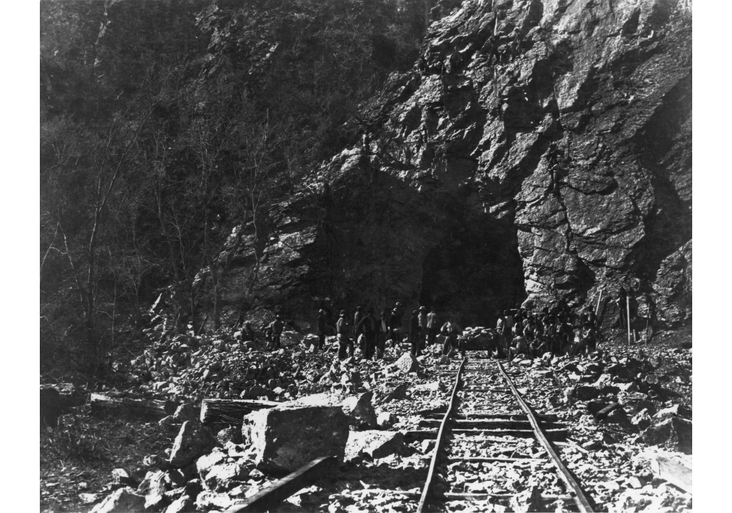
Echo & Weber Canyon Tunnels
Notes:
1. “The Echo and Weber canyons were the most difficult terrain through which Union Pacific had to build. Several tunnels were required in these narrow canyons, and floods washed out both grading and bridges.
2. Have students label Echo Canyon and color them tan/peach.

Slide 4
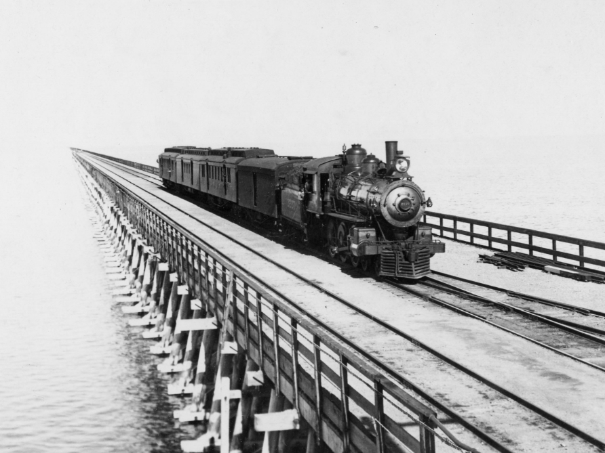
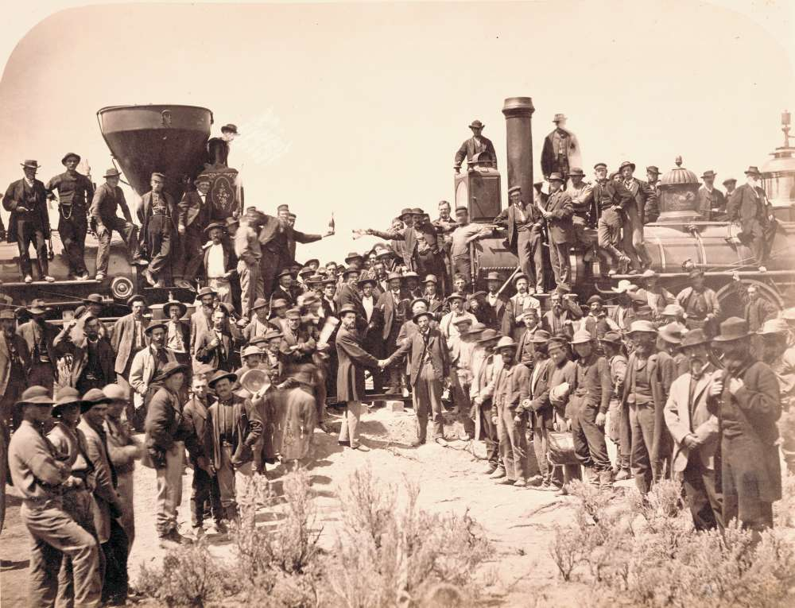
Central Pacific
Union Pacific
Notes:
1. Point out the purple dot. In 1869 This the Central Pacific Railroad Company entered Utah. They needed to meet up with the Union Pacific Railroad Company, but what landform is in their way? What are their options? Which would be the quickest way for the company to lay their tracks?
2. The Central Pacific laid tracks heading towards the north of the Great Salt Lake.
3. [CLICK] The dark red line shows the route that these two companies took
4. Have students draw a red line to show the route.
5. The two companies met at Promontory Summit on May 10, 1869.
6. [CLICK] In 1904, a shortcut was built across the Great Salt Lake this was known as the Lucin Cutoff.
7. Have students draw an orange dotted line to show the Lucin Cutoff.

