Slide 1
Teamwork and Competition on the Transcontinental Railroad

Slide 2
TEAMWORK
Notes:
Ask students if they have ever experienced a situation in which it was easier to accomplish a task by working as a group than it would have been to have worked on the task alone? (Answers will vary but may include playing sports, shoveling snow, or moving personal possessions.)

Slide 3
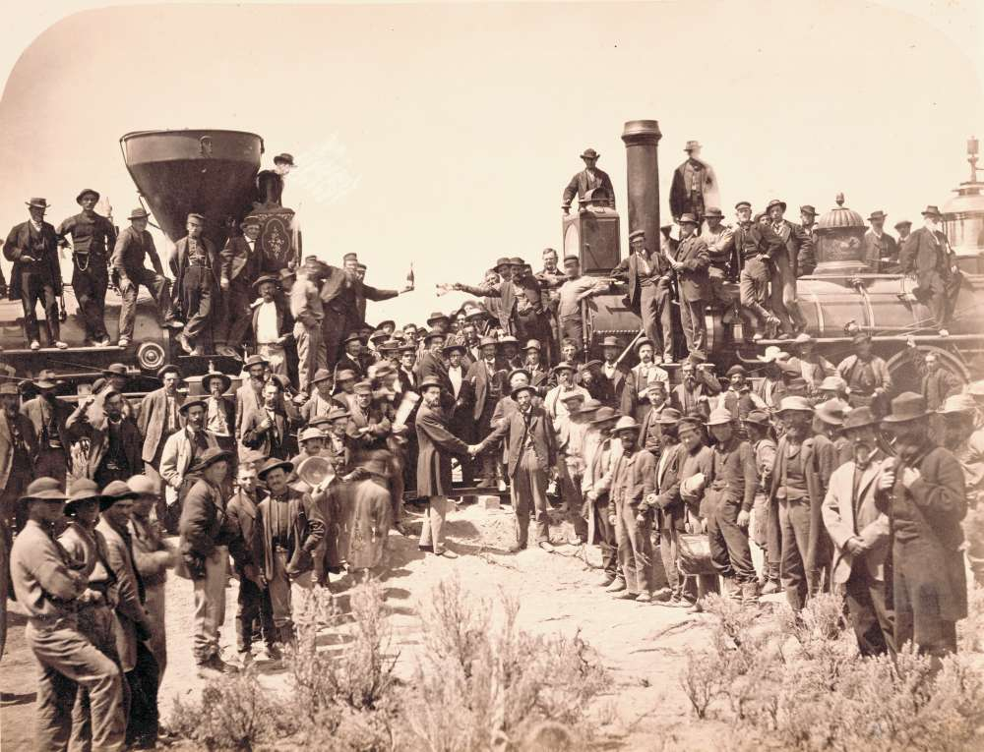
Notes:
Tell students that you will be reading a story about the building of the transcontinental railroad, a railroad that connected the East Coast of the United States with the West Coast of the United States, and how the railroad work crews were able to successfully complete the transcontinental railroad in record time. Emphasize to students that the completion of the transcontinental railroad was a great accomplishment. The railroad brought goods, services, and people from the East to the West and vice versa.

Slide 4
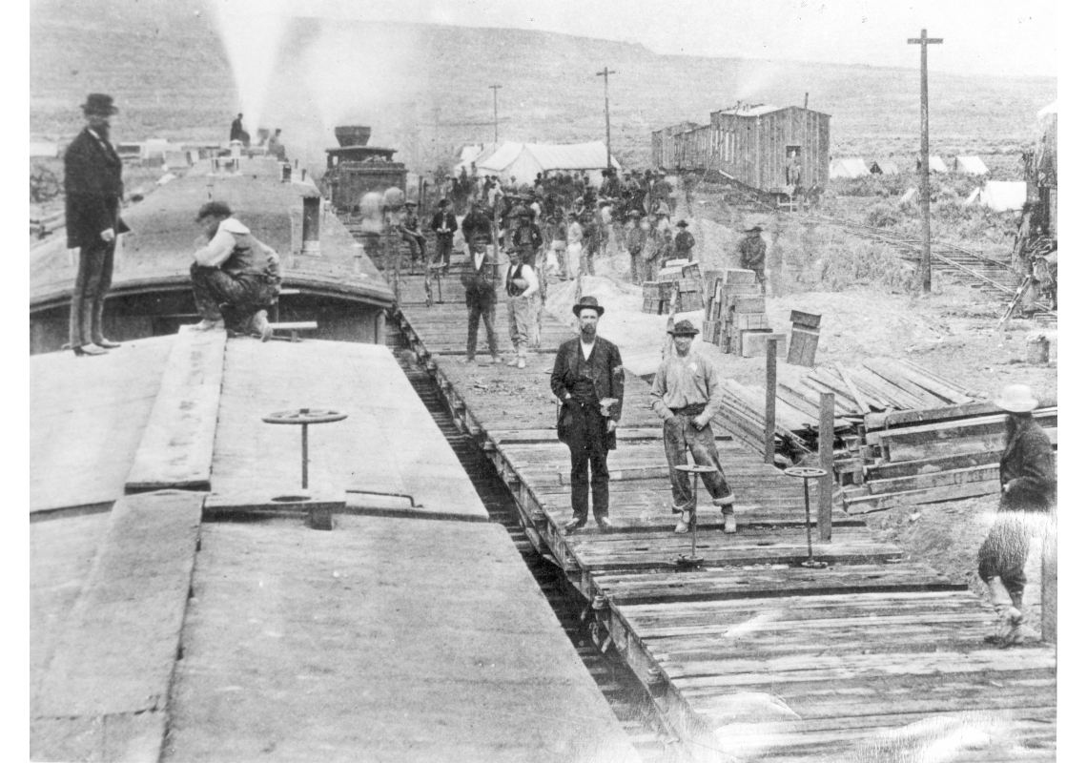
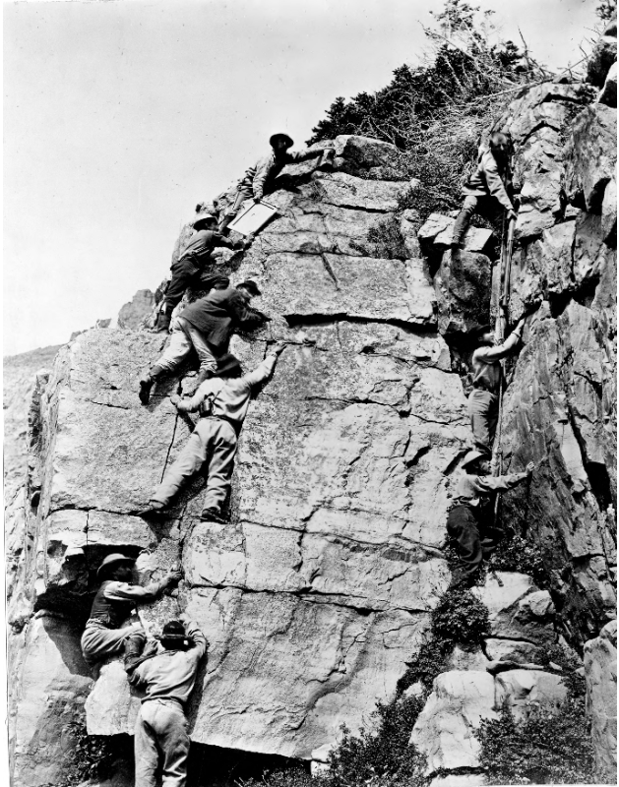
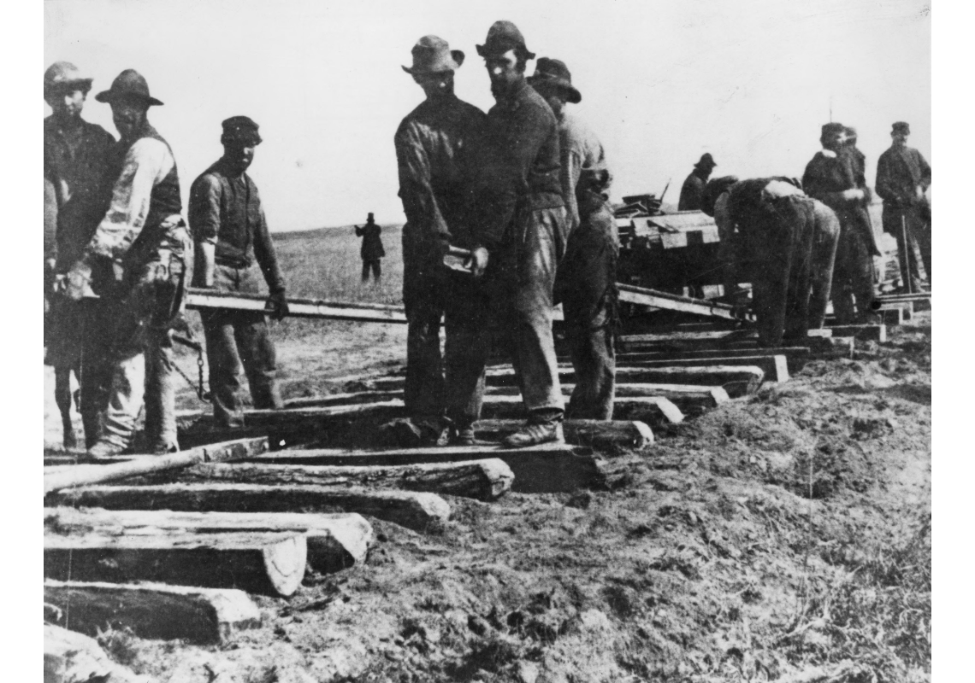
Notes:
Completion of the railroad took highly motivated, hard-working, resourceful, and very productive work crews such as the Chinese, Irish, and in Utah, the Mormons. Tell the students that productive means producing or making goods and services. In the story, the workers produce the service of laying railroad track. Students are productive, too. They produce projects, complete school work and so on. You could discuss how students can be productive at home or how their parents are productive.

Slide 5
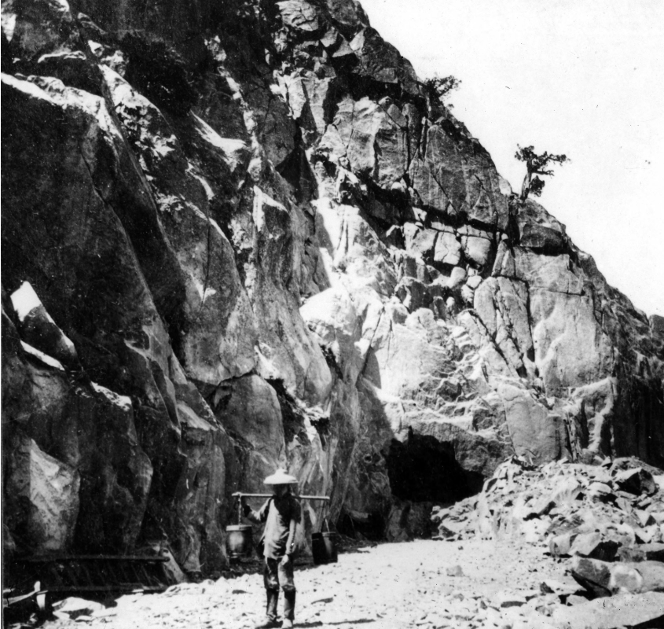
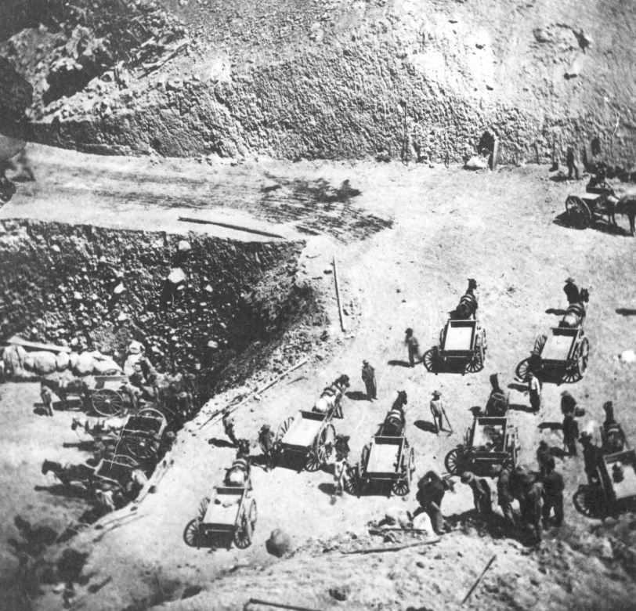
Over 12,000 Chinese immigrants
Employed by the Central Pacific
Notes:
The Transcontinental Railroad was a huge project and people came from all over the world to help build it. It could not have completed without the Chinese and Irish laborers, who made up most of the workforce. Over 12,000 Chinese immigrants were employed by the Central Pacific. That’s about 80% of their workforce. They impressed people by their willingness to do the dangerous work. Let students know that story they’re about to hear is about one of these groups that laid a record of ten miles of track in just twelve hours.

Slide 6
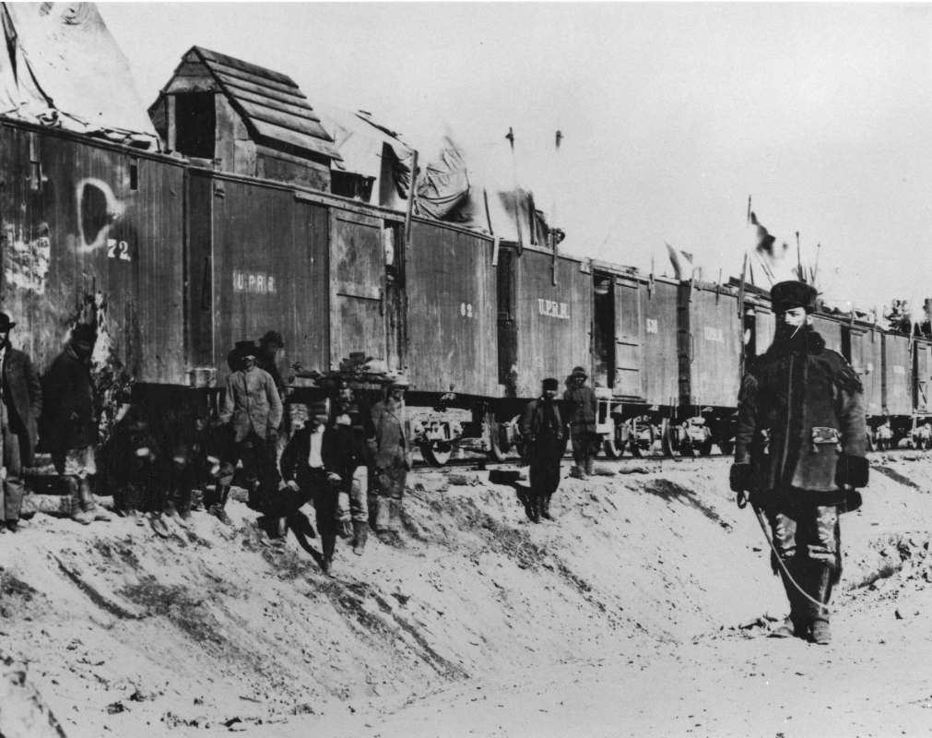
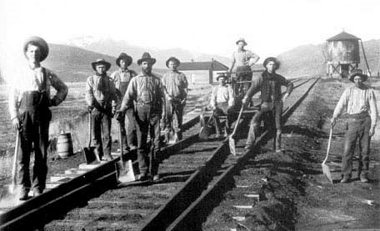
3,000 Irish immigrants: Many were veterans of the American Civil War
Mostly employed by the Union Pacific
Notes:
Around 3,000 Irish immigrants were employed by the Union Pacific. Many of these Irish laborers were from the Eastern Seaboard who were veterans of the Union and Confederate armies during the Civil War.

Slide 7
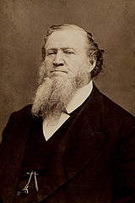
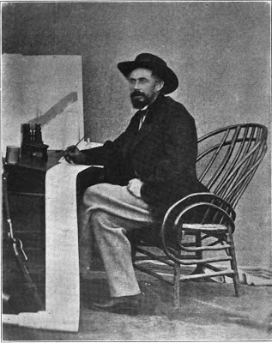
Brigham Young
Samuel B. Reed
Notes:
When the Union Pacific was trying to make their way through the Rocky Mountains, specifically the Wasatch range, they decided to ask for help from the group of people living on the other side. Samuel B. Reed from the Union Pacific asked the Mormons for help doing one million dollars’ worth of grading, tunneling, and bridge work from the Utah-Wyoming border west to the shores of the Great Salt Lake and to wherever they end up meeting with the Central Pacific. Brigham Young, their leader at the time agreed.
Mormon workers became experts in the use of nitroglycerin "blasting oil" and other explosives used to help tunnel through rock formations and carve out roadbeds from steep, rocky hillsides.”

