Slide 1
Oral Language
Jennifer Throndsen
PreK-12 Literacy and Library Media Coordinator
Utah State Board of Education

Slide 2
That’s Me
Notes:
That’s me—ask questions like K teacher, 1st grade…less than 5 years experience, more than 5 etc.

Slide 3
Learning Targets
Learning Intentions
Success Criteria
Participants will understand the principles of effective oral language instruction.
I can describe the principles of effective oral language instruction.

Slide 4
Define Oral Language
In the literacy classroom,
What does oral language involve?
How do you engage students in oral language practice?

Slide 5
Oral Language Defined
Proficiency in speaking and listening to oral language involves the ability to acquire, practice, and integrate linguistic, symbolic, and practical knowledge across the domains of sound units, semantics (vocabulary), morphology, syntax, and social use. (Gillam & Reutzel, 2013)
Oral language is what is used to express ourselves verbally and is the ability to understand the language produced by others. (Cavanaugh, 2012).
Any activities designed to teach language concepts, vocabulary, and background knowledge, as well as those activities designed to promote listening comprehension.
Notes:
add some definitions from literature to set a common language and understanding for the presentation
Have participants take a few moments to read the definitions and reflect with a partner on how the definitions are similar or different than their own. Have a few volunteers share the similarities/differences they found.

Slide 6
Myths
Myth 1: Children are word sponges
Myth 2: There is a vocabulary explosion
Myth 3: Storybook reading is sufficient for oral vocabulary development
Myth 4: We do it all the time
Myth 5: Just follow the vocabulary scope and sequence in our core reading program
Notes:
Jigsaw the 5 myths...
Either assign tables to be 1s, 2,s…etc. or number participants off 1-5
Use their note taking guide to take notes on their myth
They will then regroup with 1-5 and teach each other about each of the myths and add to their note taking chart

Slide 7
Principles of Instruction
#1 Children need both explicit and implicit instruction
#2 Be intentional with word selection
#3 Build word meaning through knowledge networks
#4 Children need repeated exposure to gain vocabulary
#5 Ongoing professional development is essential to teachers to accelerate children’s oral vocabulary knowledge

Slide 8
Principle #1 Children need both explicit and implicit instruction
Give student-friendly definitions of words or other attributes of words to be learned—more likely to remember them
Highlight words prior to the text that are integral to the story—encourage them to listen for them and raise their hand when they hear them
Make children aware of the meaning of the words and then engage them in using those words in a meaningful context

Slide 9
Principle #2 Be intentional with word selection
Only so many words we can teach in a year—400 words
Focus of explicit word instruction should be on Tier 2 words—words with high utility
Content related words are also critical for developing knowledge in key subject areas (e.g, habitat, organism, protection)

Slide 10
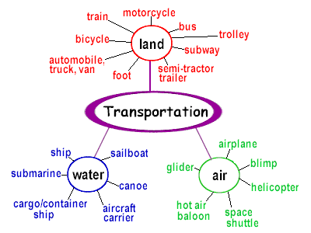
Principle #3 Build word meaning through knowledge networks
Identify a set of interconnections and concepts
How do these words work together?
Words presented in integrated contexts are useful and help children to make sense of them.
Notes:
How do these words work together? Have children consider two words and make inference about how those words work together.

Slide 11
Principle #4 Children need repeated exposure to gain vocabulary
Notes:
Only a small percentage of children will remember a word with 3 or less repetitions. Most will need many more…more like 24 repetitions to remember a new word.
Repeated reading can help student acquire new words.’’
Teaching knowledge networks—is a built-in mechanism for repeating words
Rich explanations with student friendly definitions, synonyms, images, and the use of words in context allow opportunities for students to hear and use the word more.

Slide 12
Principles in Action
Step 1: Read
Step 2: Explicit/Implicit Vocabulary (3-5 words)
Step 3: Word Selection for Explicit—Why?
Step 4: Knowledge Networks
Step 5: Repetition
Notes:
Read the Day the Crayons Quit,
have participants look back through, considering the principles of instruction, and
Step 1: Read—skim back over the text looking for words that would be useful for instruction and future access
Step 2: Explicit/Implicit Vocabulary 3-5 words for instruction
Step 3: Word Selection—determine which words would be used for explicit instruction and why
Step 4: Knowledge Networks—how might you build a knowledge network with this text? Could it tie into a bigger idea or theme or concept?
Step 5: Repetition—how might you provide opportunities for repetition?

Slide 13
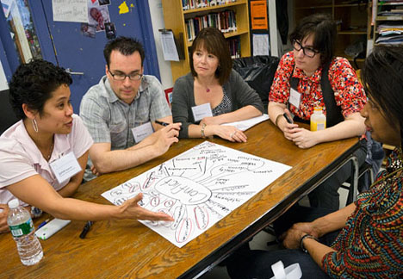
Principle #5 Ongoing professional development is essential to teachers to accelerate children’s oral vocabulary knowledge
Notes:
Student’s oral vocabulary development is highly malleable and can be significantly improved through instruction.
Teachers need to provide systematic opportunities for children to learn words and to ensure that they receive a high-quality variety of oral language instruction. This can be best accomplished through engaging discussions and collaborations among students.
Pattern of instruction involves:
identifying words that need to taught
defining these words in a student-friendly way
Contextualizing words into varied and meaningful formats
Reviewing words to ensure sustainability over time, and
Monitoring children’s progress and reteaching if necessary

Slide 14
Think About It
Which “myths” about oral vocabulary instruction might this teacher hold?
What “principles” of vocabulary instruction could she use to enhance this instruction?
Notes:
Scenario: It’s circle time in this kindergarten class, and the teacher is reading a favorite storybook, Rainbow Fish and the Whale. As she reads, she stops and points to the picture of the whale. “Look,” she says to the children, “Here’s a whale and its baby. A baby whale is called a calf,” as she continues on to the next page. The word is never repeated.
Setup the scenario, then have the participants reflect back on the myths and have them discuss the questions in groups of 2-3.
Example answer: This teacher used a “teachable moment” to introduce children to an interesting new word. We know that providing a child-friendly definition of a word in a meaningful context is helpful for developing vocabulary knowledge.
At the same time, it’s useful to remember that children are not “word sponges” (Myth 1). Further, brief explanation of words during teachable moments will not be sufficient for building deep and lasting understandings of word meanings (Myth 4).
From All About Words p. 17 by Neuman and Wright

Slide 15
Notes:
10-15 minute break—when we come back we will look at instructional strategies you can use to overcome these 5 challenges

Slide 16
Oral language is foundation for learning to read. It is the entry point to concepts and comprehension.
Neuman & Wright (2013)

Slide 17
Se
Productive Partnering
Notes:
Now it is one thing to know about the principles and the myths….it is another thing to actually have young students engage in productive conversations. Let’s take a look at what the standards are asking K-1 students to do.

Slide 18
Speaking and Listening Standard 1
S.L.K.1 Participate in collaborative conversations with diverse partners about kindergarten topics and texts with peers and adults in small and larger groups.
A) Follow agreed-upon rules for discussions (e.g., listening to others and taking turns speaking about the topics and texts under discussion).
B) Continue a conversation through multiple exchanges.
S.L.1.1 Participate in collaborative conversations with diverse partners about grade 1 topics and texts with peers and adults in small and larger groups.
A) Follow agreed-upon rules for discussions (e.g., listening to others with care, speaking one at a time about the topics and texts under discussion).
B) Build on others' talk in conversations by responding to the comments of others through multiple exchanges.
C) Ask questions to clear up any confusion about the topics and texts under discussion.
Notes:
Read your grade level standards…write a one sentence summary of the key ideas of standard 1.
Share out their summary with a partner.
Cold-call on 2-3 people to share their definitions.—if yours was similar to those shared thumbs up.
Let’s take a look at how such collaborative conversation opportunities could be supported.

Slide 19
Notes:
4Ls of Productive Partnering
Poster-4Ls

Slide 20
Looking & Leaning = You are Focused on Your Partner
Focusing a Camera
Looking and leaning indicates you are focused on your partner -- and not distracted by other people or things.
20

Slide 21
Academic Interactions Use a Private, Scholarly Voice
Move your hands away from your face.
Make eye contact.
Speak 2x slower.
Speak loud enough to be heard over other classmates.
Pause appropriately.
Emphasize key words.

Slide 22
Partner Responsibilities
Contribute thoughtfully and audibly.
Listen attentively to your partner’s ideas.
Provide helpful feedback.
Let your partner know if you do not fully understand his/her ideas.
Remember your partner’s ideas.

Slide 23
Goals: Applying the 4 Ls
To implement the 4 Ls effectively, I plan to 1) 2) 3)
Notes:
Note taking guide….quick write

Slide 24
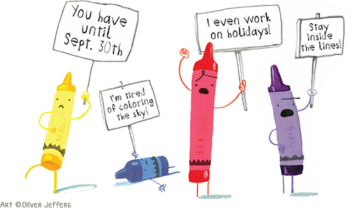
Structured Language Activities
In the context of text
Notes:
Now that our students know how to engage in productive partners…let’s look at a few language activities that can support their achievement of the standards.

Slide 25
Speaking and Listening Standard 2 & 3
S.L.K.2 Confirm understanding of a text read aloud or information presented orally or through other media by asking and answering questions about key details and requesting clarification if something is not understood.
S.L.K.3 Ask and answer questions in order to seek help, get information, or clarify something that is not understood.
S.L.1.2 Ask and answer questions about key details in a text read aloud or information presented orally or through other media.
S.L.1.3 Ask and answer questions about what a speaker says in order to gather additional information or clarify something that is not understood.

Slide 27
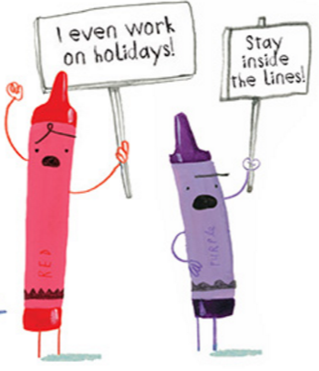
Think-Pair-Share #1
Why are red and purple upset with Duncan?
Notes:
1. Prior to the discussion, the teacher numbers the students off as a “1” or a “2.”
2. Teacher poses a question
3. Teacher provides students some think time to consider how they might respond to the question posed.
4. Teacher cues the 1’s to speak while 2’s listen.
5. After enough time has been provided for 1’s to speak, 2’s are asked to speak.
6. Teacher calls the students’ attention back to the whole group. Students are selected to share what their partners had to say.
Encourage participants to use the 4Ls in their discussion.

Slide 28
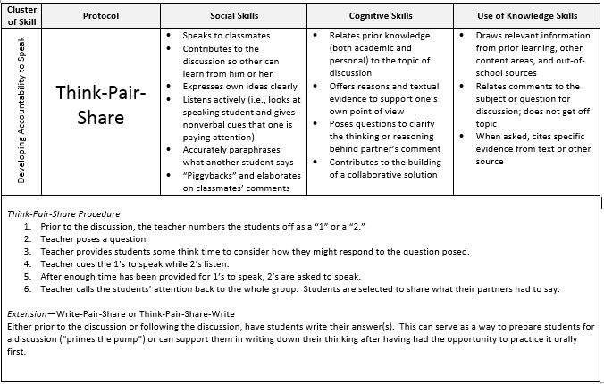
Notes:
1. Prior to the discussion, the teacher numbers the students off as a “1” or a “2.”
2. Teacher poses a question
3. Teacher provides students some think time to consider how they might respond to the question posed.
4. Teacher cues the 1’s to speak while 2’s listen.
5. After enough time has been provided for 1’s to speak, 2’s are asked to speak.
6. Teacher calls the students’ attention back to the whole group. Students are selected to share what their partners had to say.

Slide 29
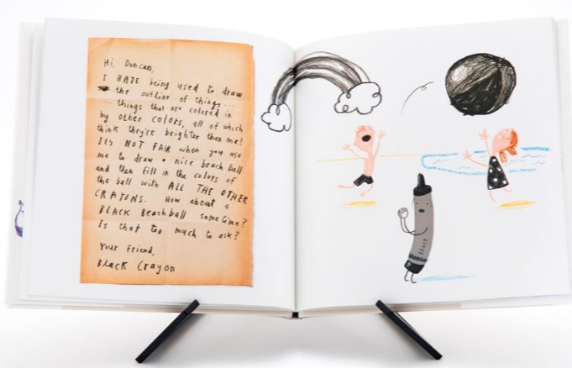
Think-Pair-Share #2
How might Duncan solve Beige, Gray, White, or Black’s complaints?
Notes:
Partner 2 go first this time.

Slide 30
Think-Pair-Share--Practice
Read the last half of the text
Construct 2 more think-pair-share questions to facilitate partner discussion

Slide 31
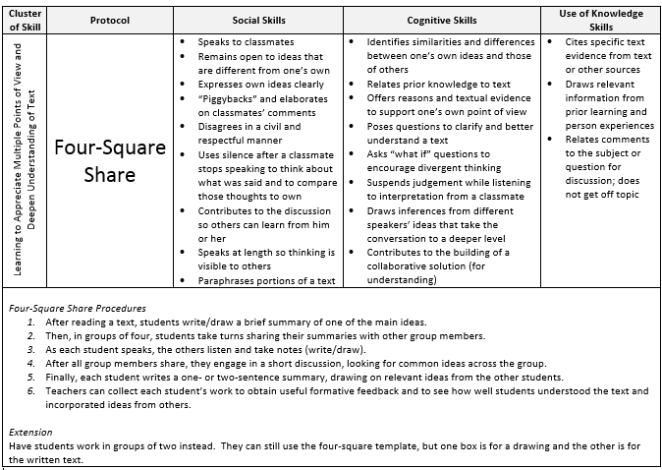

Slide 32
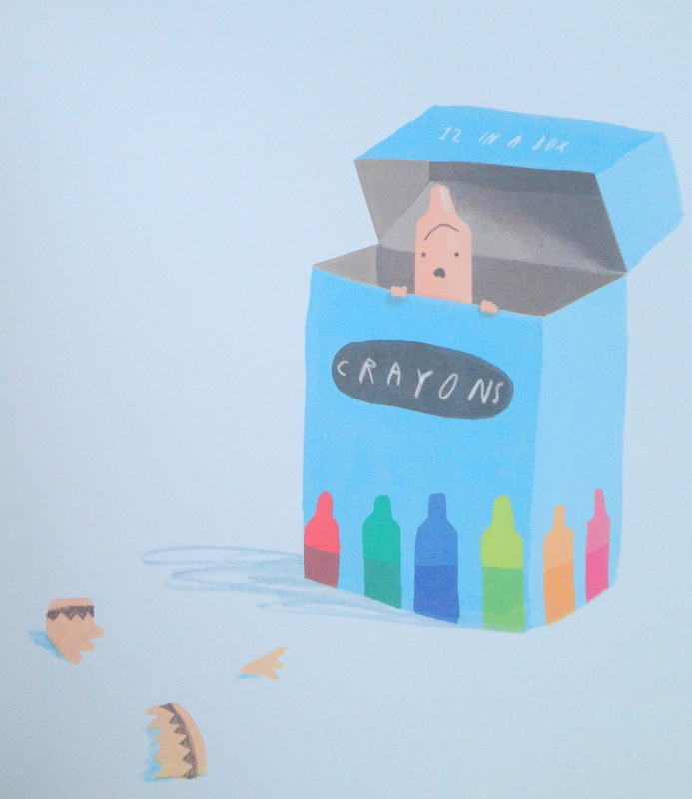
Four-Square Share
Notes:
One for today’s task is in the note-taking guide…this template is for classroom use
Four-Square Share Procedures
After reading a text, students write/draw a brief summary of one of the main ideas.
Then, in groups of four, students take turns sharing their summaries with other group members.
As each student speaks, the others listen and take notes (write/draw).
After all group members share, they engage in a short discussion, looking for common ideas across the group.
Finally, each student writes a one- or two-sentence summary, drawing on relevant ideas from the other students.
Teachers can collect each student’s work to obtain useful formative feedback and to see how well students understood the text and incorporated ideas from others.

Slide 33
Notes:
IQ Pairs Procedures
Teacher asks each pair of students to identify an insight (something they have learned or an “aha” experience) and a question they have about the topic.
After pairs have had some time to discuss, they are asked to merge with another pair of students.
The pairs then share their respective insights, pointing to the position in the text from which each insight emerged and elaborating on what it means.
Then, each pair poses its question, talking about why this is a puzzle and how they might go about investigating in.
Teacher brings the whole group back together and facilitates sharing and further discussion.

Slide 34
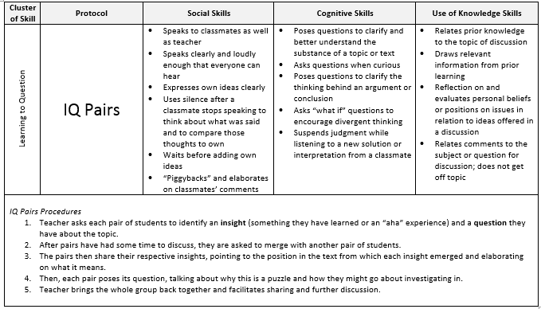

Slide 35
Resources
http://uen.org/syc
Epic Books
http://www.uen.org/core/languagearts/performancetasks/
http://www.uen.org/pls
http://www.schools.utah.gov/CURR/langartelem/Core.aspx
Vertical Alignment of the ELA Standards

Slide 36
Questions?
Jennifer Throndsen
Utah State Board of Education
PreK-12 Literacy and Library Media Coordinator
jennifer.throndsen@schools.utah.gov

Slide 37
Next…
 | Day 1 AM | Day 1 PM | Day 2 AM | Day 2 PM
Group 1-Blue | PA | Phonics | Oral Language | Writing
Group 2-Red | Phonics | Oral Language | Writing | PA
Group 3-Yellow | Oral Language | Writing | PA | Phonics
Group 4-Green | Writing | PA | Phonics | Oral Language

