Slide 1
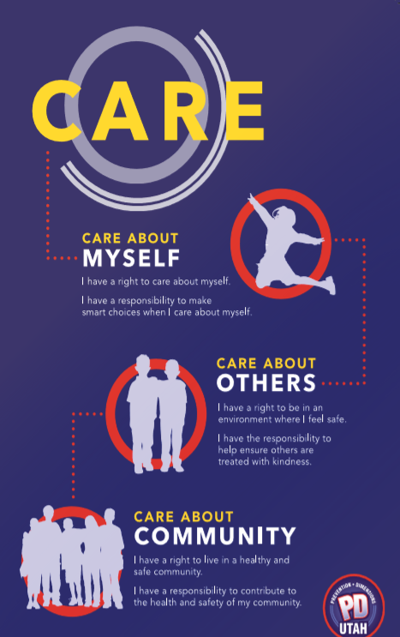
Prevention Dimensions
Lesson 1 – Feeling, “I” Messages, IALAC

Slide 2
Emotions Video

Slide 3
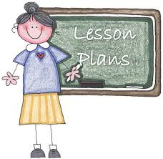
Model a Strategy of the Lesson Plan

Slide 4
Labels Video

Slide 5
Utilizing Youth Groups
Governor’s Youth Council
Impact Teams
Peer Leadership

Slide 6
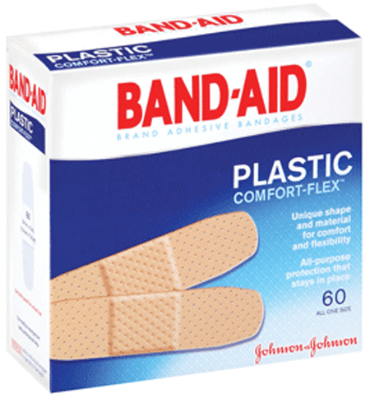
Power of Music
“I am stuck on Band-Aids cause….”
“Like a good neighbor….”
“Plop, plop, fizz, fizz….”
“The choice is yours at….”
Tony the Tiger says, “They’re….”

Slide 7
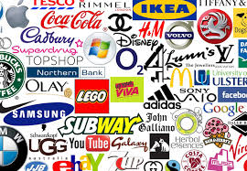
Advertising Works

Slide 8
Peter Yarrow

Slide 9
Baby Jay

Slide 10
Mark Wills

Slide 11
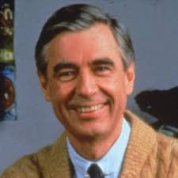

Slide 12
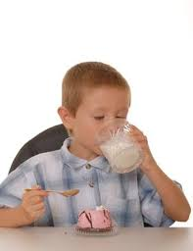
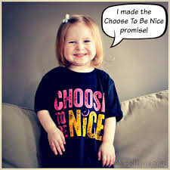
Power of Music

Slide 13
Relaxation Video

Slide 14
Anger Lesson Video

Slide 15
Review Lesson
1

